Slide 1
Functional linear models
MQT 8003 – Statistical learning methods and applications
Session 12
FDA Chapters 9 (Sections 9.1-9.4.3), 10 (Sections 10.1.1, 10.4)
9 April 2020

Slide 2
Summary of previous session
What is functional data analysis?
Overview and examples
First steps in functional data analysis
Computing curves from raw data
Basis functions
Computing curves using smoothing

Slide 3
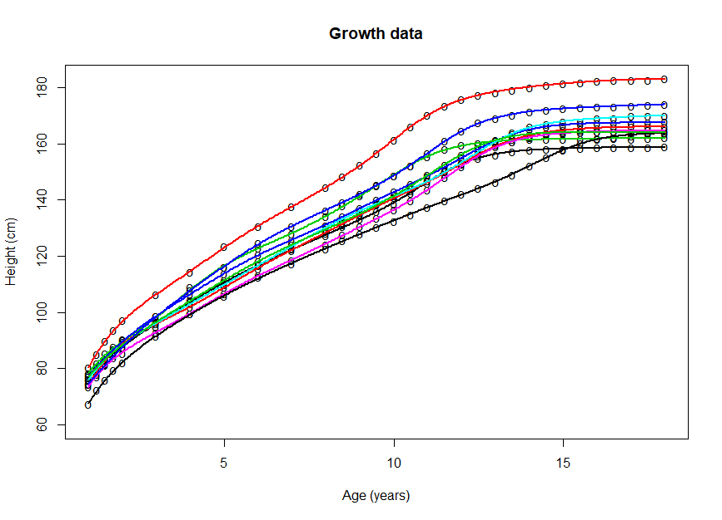

What is functional data analysis?
Functional data analysis:
Statistical analysis of samples of curves
One of the variables in the dataset can be naturally viewed as a smooth curve or function (often measured with noise)
$$y_{ij}=x_{ij}\left(t_{ij}\right)+ε_{ij}$$
where $t$ varies over a continuum (e.g. time)
$x_{i}\left(t\right)$ is a smooth curve, the functional datum
$ε_{ij}$ is the measurement error (noise)
What is functional data analysis?

Slide 4
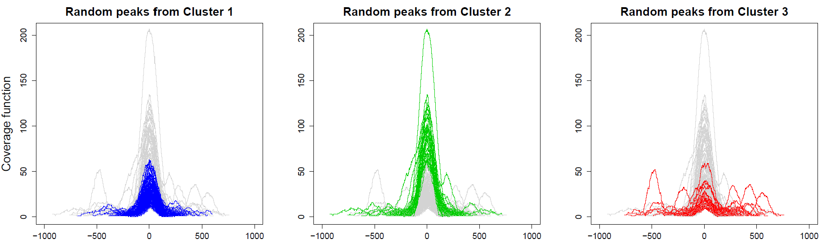
What is functional data analysis?
Essential questions on functional data:
How do we go from discrete measurements
to continuous functional data? Smoothing
How do we describe random variation in functional data? Functional principal component analysis
How do we decide if groups of functional data are different? Functional hypothesis testing
How do we study the relationship between functional data and other scalar variables? And the relationship between functional data and other functional data? Functional linear models
How do we find groups of functional
data? Functional clustering
What is functional data analysis?

Slide 5
Topics
Functional linear models
Scalar-on-function models (scalar response, functional predictors)
Function-on-scalar models (functional response, scalar predictors)
Function-on-function models (functional response, functional predictors)

Slide 6
Functional linear models FDA Chapters 9 (Sections 9.1-9.4.3), 10 (Sections 10.1.1, 10.4)

Slide 7
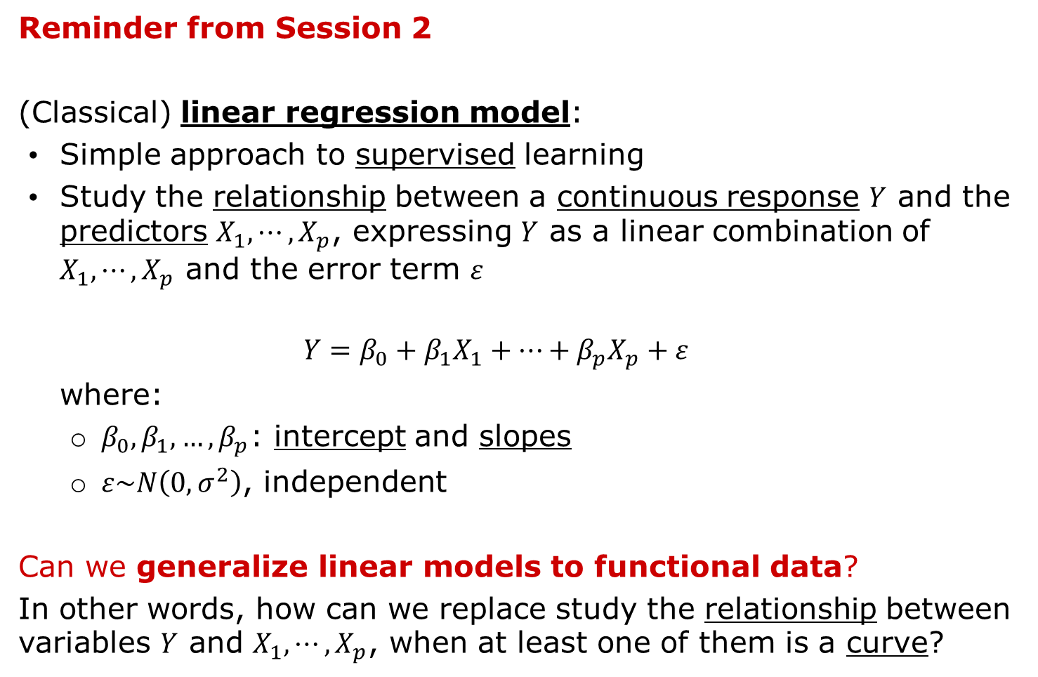
Functional linear models
Reminder from Session 2
(Classical) linear regression model:
Simple approach to supervised learning
Study the relationship between a continuous response $Y$ and the predictors $X_{1},⋯,X_{p}$, expressing $Y$ as a linear combination of $X_{1},⋯,X_{p}$ and the error term $ε$
$$Y=β_{0}+β_{1}X_{1}+⋯+β_{p}X_{p}+ε$$
where:
$β_{0},β_{1},…,β_{p}$: intercept and slopes
$ε\sim N\left(0,σ^{2}\right)$, independent
Can we generalize linear models to functional data?
In other words, how can we replace study the relationship between variables $Y$ and $X_{1},⋯,X_{p}$, when at least one of them is a curve?
Functional linear models

Slide 8
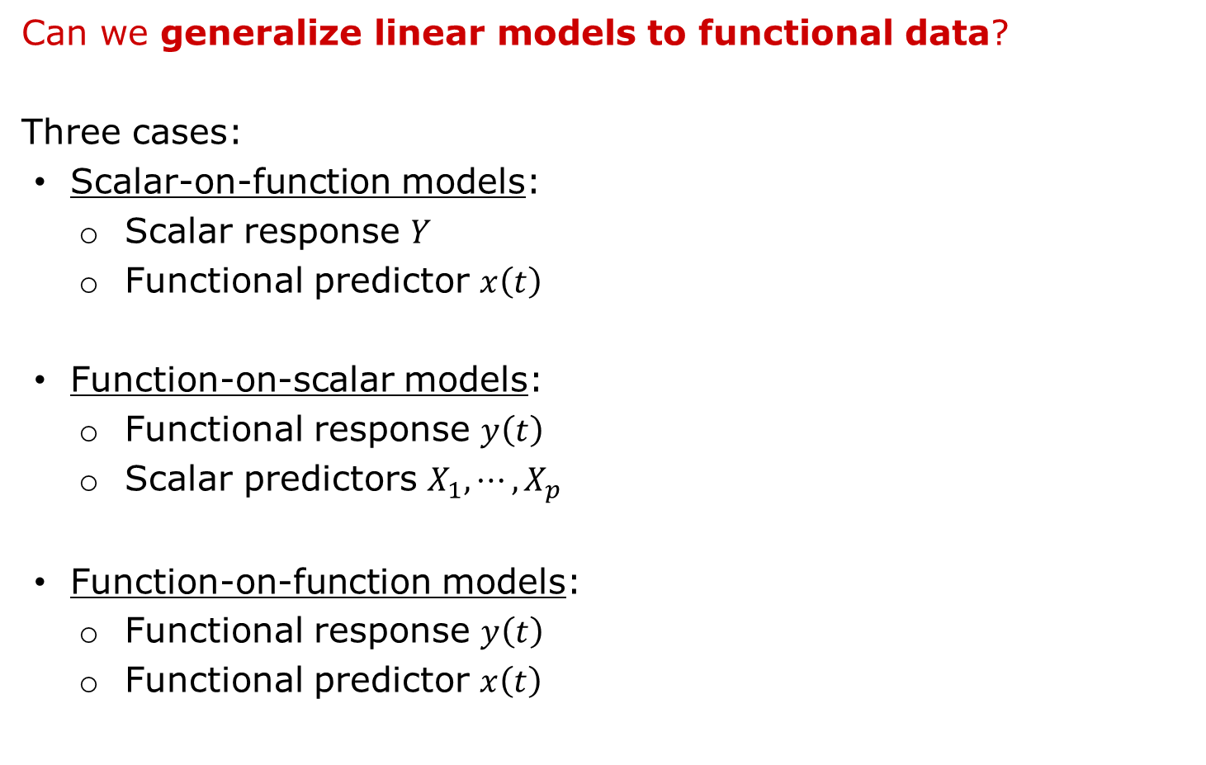
Functional linear models
Can we generalize linear models to functional data?
Three cases:
Scalar-on-function models:
Scalar response $Y$
Functional predictor $x\left(t\right)$
Function-on-scalar models:
Functional response $y\left(t\right)$
Scalar predictors $X_{1},⋯,X_{p}$
Function-on-function models:
Functional response $y\left(t\right)$
Functional predictor $x\left(t\right)$
Functional linear models

Slide 9
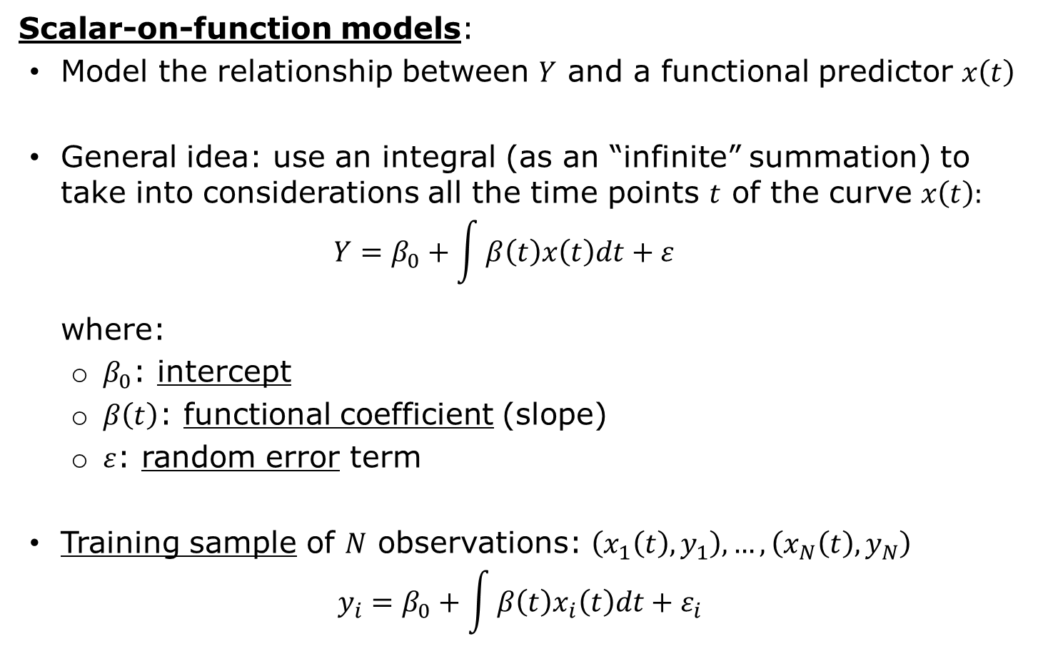
Scalar-on-function models
Scalar-on-function models:
Model the relationship between $Y$ and a functional predictor $x\left(t\right)$
General idea: use an integral (as an “infinite” summation) to take into considerations all the time points $t$ of the curve $x\left(t\right):$
$$Y=β_{0}+\int{β\left(t\right)x\left(t\right)dt}+ε$$
where:
$β_{0}$: intercept
$β\left(t\right)$: functional coefficient (slope)
$ε$: random error term
Training sample of $N$ observations: $\left(x_{1}\left(t\right),y_{1}\right),…,\left(x_{N}\left(t\right),y_{N}\right)$
$$y_{i}=β_{0}+\int{β\left(t\right)x_{i}\left(t\right)dt}+ε_{i}$$
Functional linear models

Slide 10
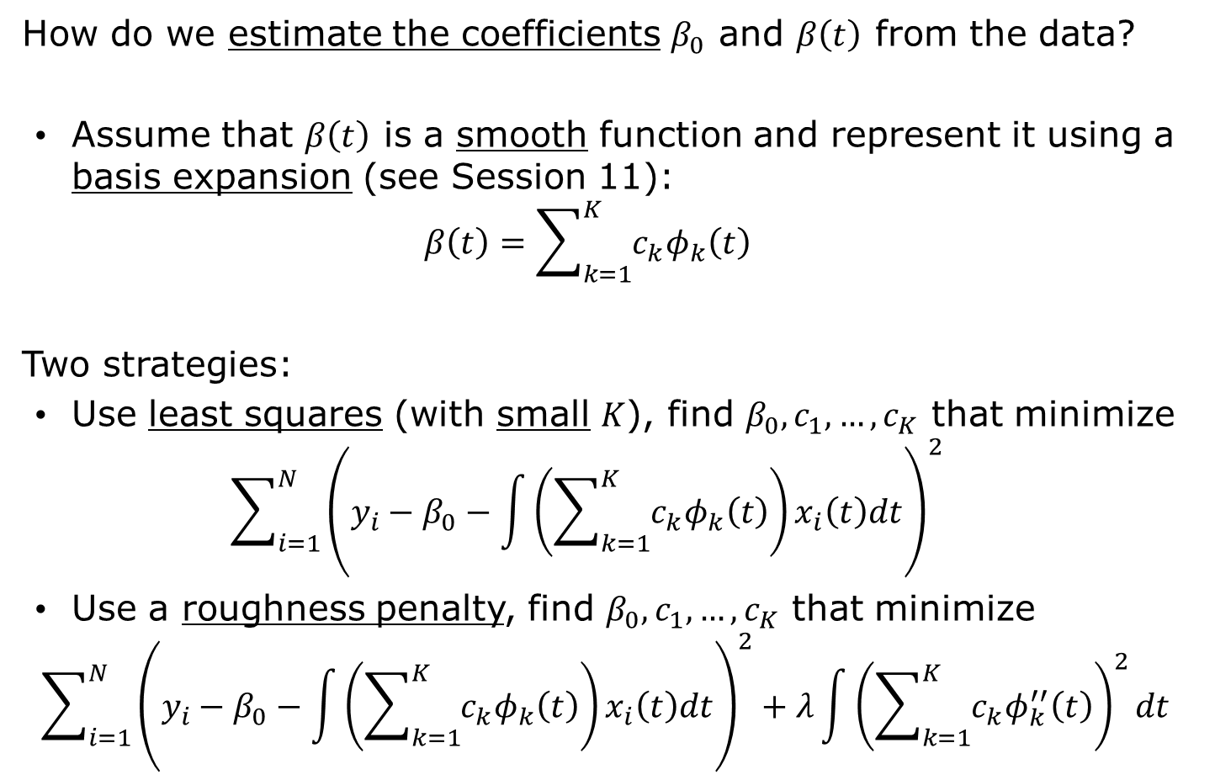
Scalar-on-function models
How do we estimate the coefficients $β_{0}$ and $β\left(t\right)$ from the data?
Assume that $β\left(t\right)$ is a smooth function and represent it using a basis expansion (see Session 11):
$$β\left(t\right)=\sum_{k=1}^{K}{c_{k}φ_{k}\left(t\right)}$$
Two strategies:
Use least squares (with small $K$), find $β_{0},c_{1},…,c_{K}$ that minimize
$$\sum_{i=1}^{N}{{\left(y_{i}−β_{0}−\int{\left(\sum_{k=1}^{K}{c_{k}φ_{k}\left(t\right)}\right)x_{i}\left(t\right)dt}\right)}^{2}}$$
Use a roughness penalty, find $β_{0},c_{1},…,c_{K}$ that minimize
$$\sum_{i=1}^{N}{{\left(y_{i}−β_{0}−\int{\left(\sum_{k=1}^{K}{c_{k}φ_{k}\left(t\right)}\right)x_{i}\left(t\right)dt}\right)}^{2}}+λ\int{{\left(\sum_{k=1}^{K}{c_{k}φ_{k}^{′′}\left(t\right)}\right)}^{2}dt}$$
Functional linear models

Slide 11
Scalar-on-function models
Example: Canadian weather
Goal: Study annual weather cycle in different Canadian locations
Data: Data: Temperature.C (daily temperature, average 1960-1994), Precipitation.mm (daily rainfall, average 1960-1994), region (climate zone) for 35 weather stations in Canada
Questions:
Is there a relationship between temperature profiles and annual precipitations?
Can we predict the annual precipitation in a Canadian locations given its temperature profile?
Look at the files Functional linear models.Rmd and/or Functional linear models.nb.html
Sections 1-2 (lines 1-204)
Functional linear models

Slide 12
Scalar-on-function models
Chapter 9
Read Sections 9.1-9.4.3
(pages 131-140)
https://link-springer-com.acces.bibl.ulaval.ca/book/10.1007%2F978-0-387-98185-7
Functional linear models

Slide 13
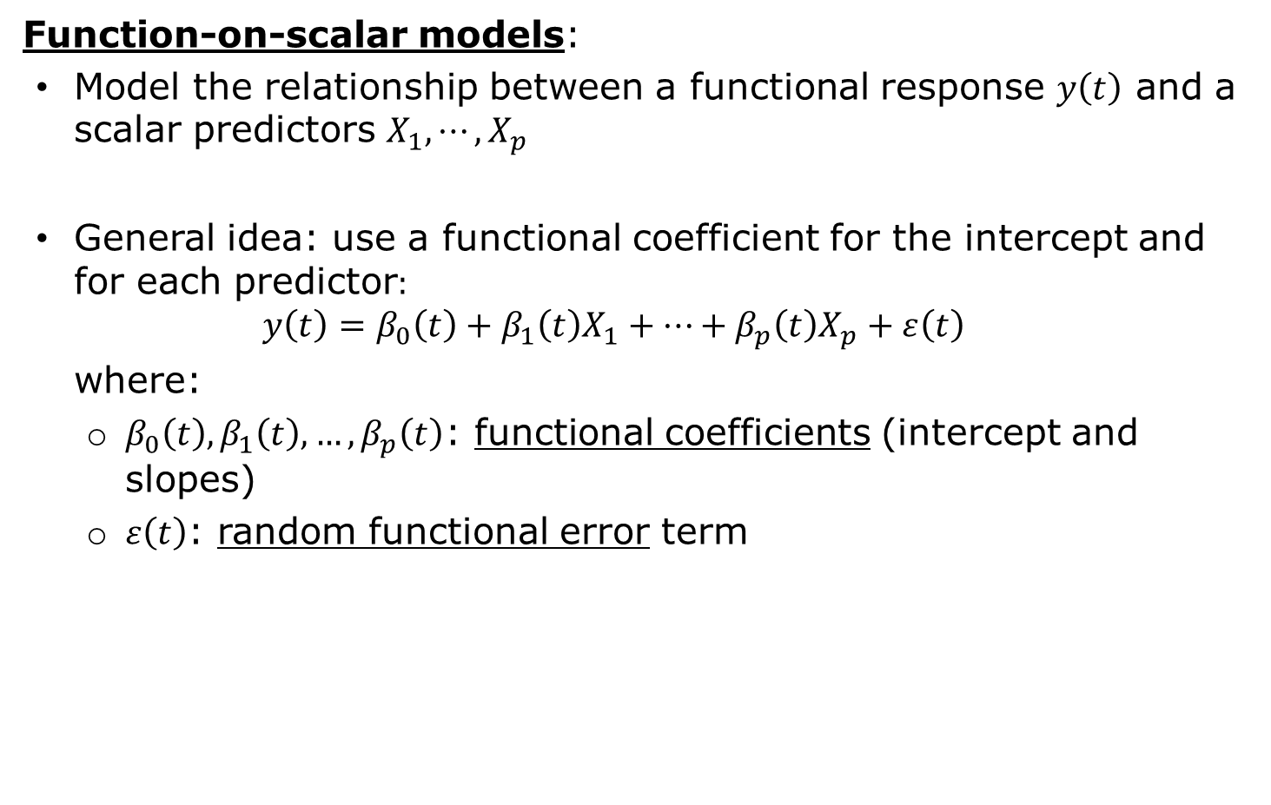
Function-on-scalar models
Function-on-scalar models:
Model the relationship between a functional response $y\left(t\right)$ and a scalar predictors $X_{1},⋯,X_{p}$
General idea: use a functional coefficient for the intercept and for each predictor$:$
$$y\left(t\right)=β_{0}\left(t\right)+β_{1}\left(t\right)X_{1}+⋯+β_{p}\left(t\right)X_{p}+ε\left(t\right)$$
where:
$β_{0}\left(t\right),β_{1}\left(t\right),…,β_{p}\left(t\right)$: functional coefficients (intercept and slopes)
$ε\left(t\right)$: random functional error term
Functional linear models

Slide 14
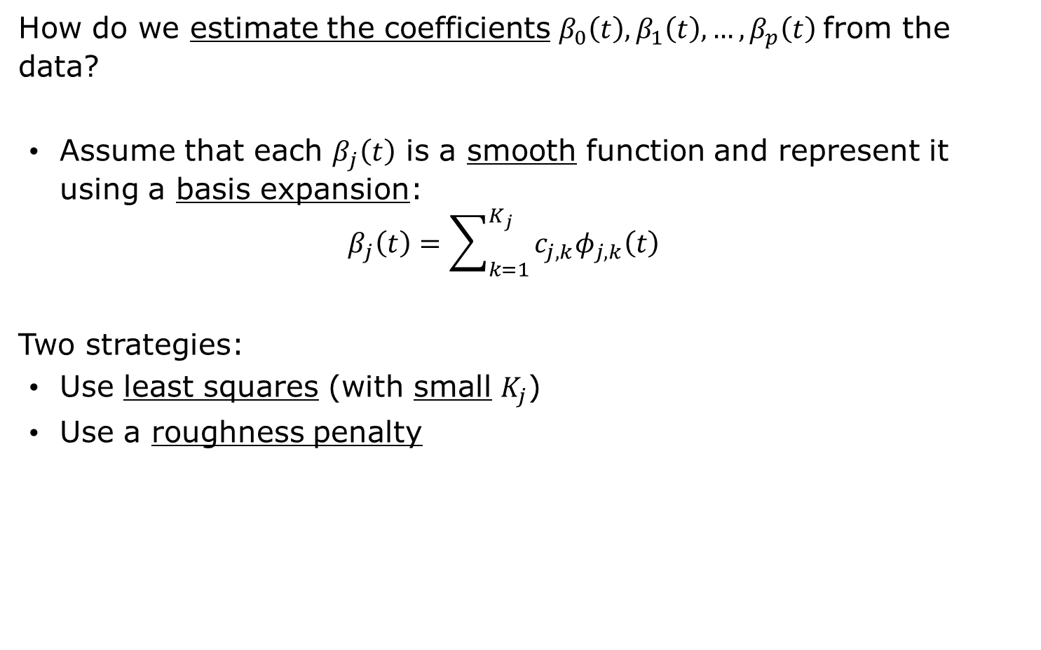
Function-on-scalar models
How do we estimate the coefficients $β_{0}\left(t\right),β_{1}\left(t\right),…,β_{p}\left(t\right)$from the data?
Assume that each $β_{j}\left(t\right)$ is a smooth function and represent it using a basis expansion:
$$β_{j}\left(t\right)=\sum_{k=1}^{K_{j}}{c_{j,k}φ_{j,k}\left(t\right)}$$
Two strategies:
Use least squares (with small $K_{j}$)
Use a roughness penalty
Functional linear models

Slide 15
Function-on-scalar models
Example: Canadian weather
Goal: Study annual weather cycle in different Canadian locations
Data: Temperature.C (daily temperature, average 1960-1994), Precipitation.mm (daily rainfall, average 1960-1994), region (climate zone) for 35 weather stations in Canada
Questions:
Is there a relationship between temperature profiles and climate zones?
Look at the files Functional linear models.Rmd and/or Functional linear models.nb.html
Section 3 (lines 208-274)
Functional linear models

Slide 16
Scalar-on-function models
Chapter 10
Read Section 10.1.1
(pages 147-149)
https://link-springer-com.acces.bibl.ulaval.ca/book/10.1007%2F978-0-387-98185-7
Functional linear models

Slide 17
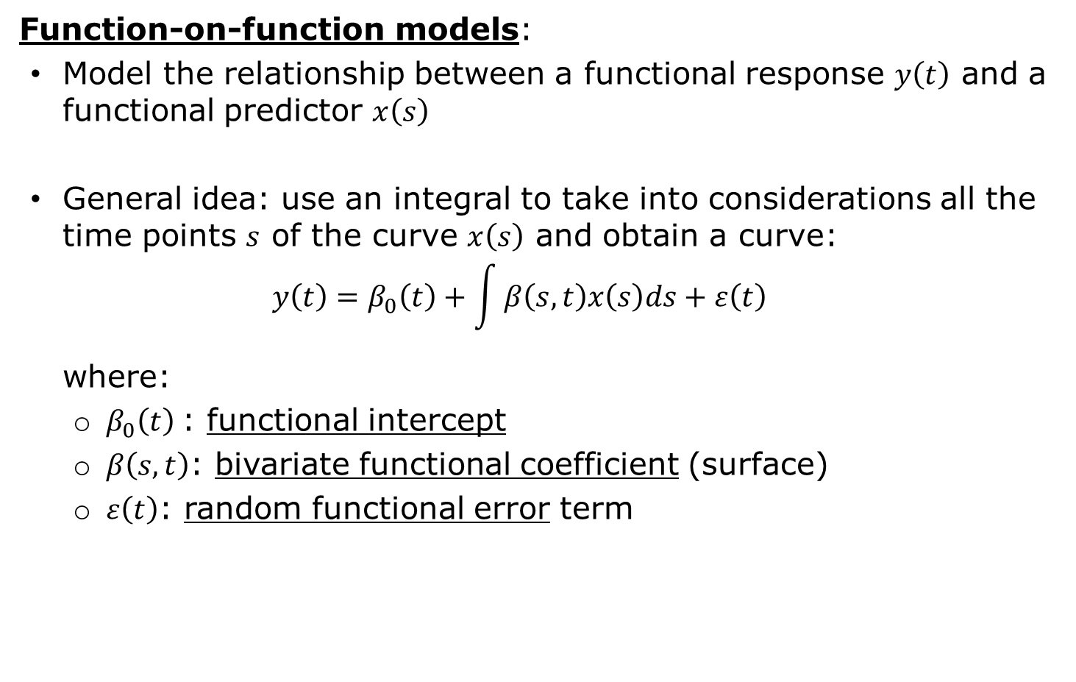
Function-on-function models
Function-on-function models:
Model the relationship between a functional response $y\left(t\right)$ and a functional predictor $x\left(s\right)$
General idea: use an integral to take into considerations all the time points $s$ of the curve $x\left(s\right)$ and obtain a curve:
$$y\left(t\right)=β_{0}\left(t\right)+\int{β\left(s,t\right)x\left(s\right)ds}+ε\left(t\right)$$
where:
$β_{0}\left(t\right)$: functional intercept
$β\left(s,t\right)$: bivariate functional coefficient (surface)
$ε\left(t\right)$: random functional error term
Functional linear models

Slide 18
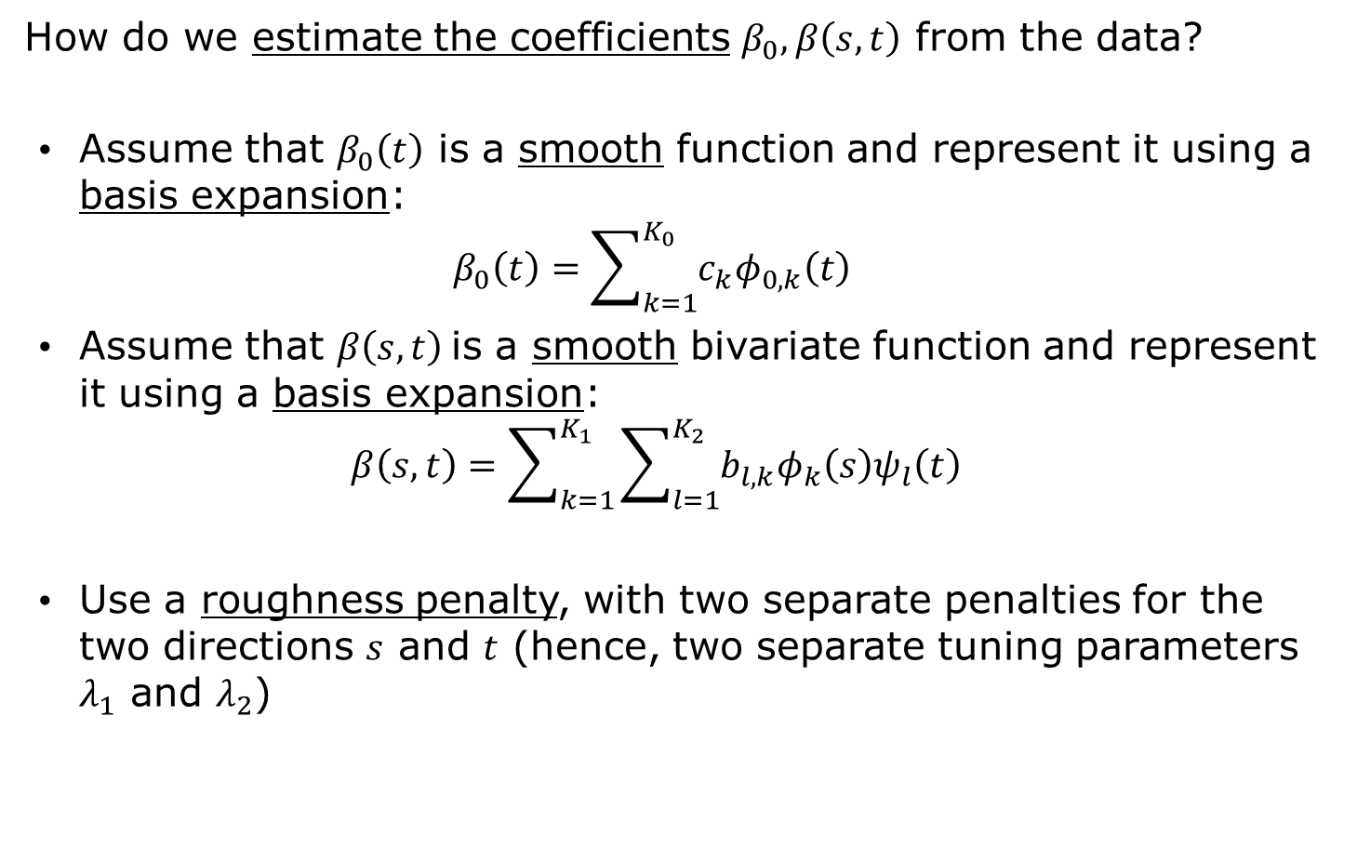
Function-on-scalar models
How do we estimate the coefficients $β_{0},β\left(s,t\right)$ from the data?
Assume that $β_{0}\left(t\right)$ is a smooth function and represent it using a basis expansion:
$$β_{0}\left(t\right)=\sum_{k=1}^{K_{0}}{c_{k}φ_{0,k}\left(t\right)}$$
Assume that $β\left(s,t\right)$is a smooth bivariate function and represent it using a basis expansion:
$$β\left(s,t\right)=\sum_{k=1}^{K_{1}}{\sum_{l=1}^{K_{2}}{b_{l,k}φ_{k}\left(s\right)ψ_{l}\left(t\right)}}$$
Use a roughness penalty, with two separate penalties for the two directions $s$ and $t$ (hence, two separate tuning parameters $λ_{1}$ and $λ_{2}$)
Functional linear models

Slide 19
Function-on-scalar models
Example: Canadian weather
Goal: Study annual weather cycle in different Canadian locations
Data: Temperature.C (daily temperature, average 1960-1994), Precipitation.mm (daily rainfall, average 1960-1994), region (climate zone) for 35 weather stations in Canada
Questions:
Is there a relationship between temperature profiles and precipitation profiles?
Look at the files Functional linear models.Rmd and/or Functional linear models.nb.html
Section 4 (lines 278-XXX)
Functional linear models

Slide 20
Scalar-on-function models
Chapter 10
Read Section 10.4
(pages 163-165)
https://link-springer-com.acces.bibl.ulaval.ca/book/10.1007%2F978-0-387-98185-7
Functional linear models

